Slide 1
Anatomy of
an agent
UC Berkeley · Master of Financial Engineering
Lesson 3 · Part 1
How agents use models, tools, and skills.
October 12, 2026
Notes:
This is the opening and first section of Lesson 3. Later sections on training, evals, and decision models remain outside this review tranche.

Slide 2
From doing the work to directing it
What changes
Domain expertise matters
Less of your effort goes into writing every line or formatting every document. More goes into defining the problem, directing the work, and assessing the result.
Experience gives you the language, patterns, and abstractions to give precise instructions, understand the system, and tackle harder problems.
What is the most ambitious automation you've tried?
Aneesh’s framing; Yang’s October 8 discussion
02
Notes:
Keep this theme brief. AI changes how the work is executed, but expertise still matters. Experience gives a director the language, systems understanding, patterns, and abstractions to give more targeted instructions, take on harder problems, and assess quality and efficacy. Ask: What is the most ambitious automation you have tried? Follow up naturally on the problem, the delegation, and where it got difficult. No time limit on the slide. The connection to Thursday is Yang’s discussion at 7:49–9:18 about understanding systems and assessing AI-produced work, not a detour into erroneous joins.
Source / attribution: Aneesh’s framing; Yang’s October 8 discussion

Slide 3
What is an agent?
An agent uses a large language model (LLM) to choose actions, use tools, and work toward a goal.
Example: analyze earnings commentary
Read the excerpts, extract margin-pressure labels with supporting quotes, and produce a feature table.
The agent decides which step to take next using the information it has.
Synthetic earnings-analysis example
03
Notes:
An agent uses an LLM to choose actions, use tools, and work toward a goal. A single model call may be useful without being an agent. Fixed workflows may also use LLMs without letting them choose the action sequence. The example is synthetic: read earnings excerpts, extract margin-pressure labels with quoted evidence, and produce a feature table. Do not claim predictive value here. https://www.anthropic.com/engineering/building-effective-agents
Source / attribution: Synthetic earnings-analysis example

Slide 4
State, observations, and actions
State
What exists in the environment
The earnings files and the current feature table.
Observation
What the agent can see
An excerpt returned by a tool or a screenshot of the table.
Action
What the agent chooses to do
Read a file, run Python, or edit the table.
Agent–environment concepts; schematic examples
04
Notes:
State is the situation in the environment. The agent only sees observations, which may be a partial view of that state. An action can retrieve information or change the environment. Example: files and the current table are state; a returned excerpt or screenshot is an observation; read_excerpt or running Python is an action. The harness also maintains internal task state. We will introduce reward when discussing reinforcement learning in the next section, not teach it here.
Source / attribution: Agent–environment concepts; schematic examples

Slide 5
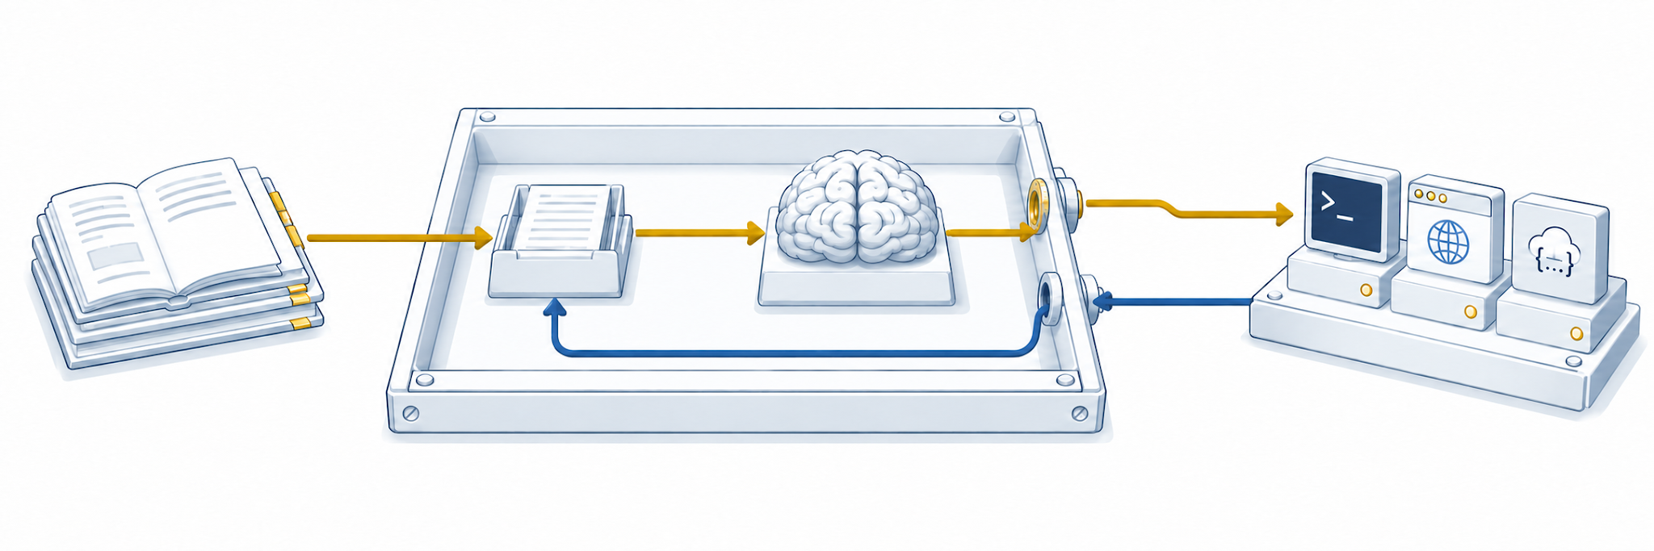
Brain, harness, tools, and skills
Harness
Skills
Tools
Tool
request
Guidance
Model input
Execute
Context
Brain (LLM)
Tool result
Procedures and
examples
Prepares context, executes calls,
and tracks progress
Files, code, apps,
and APIs
The harness manages the loop between the LLM and its tools.
Functional agent diagram; four-part teaching model
05
Notes:
The brain is the LLM. The harness prepares context, runs the loop, executes calls, maintains task state, manages permissions, and controls stopping. Tools read or change external state and return observations. Skills provide procedures, examples, and scripts; relevant guidance is loaded into context. Skills can also include scripts invoked through tools, which is not drawn as a separate edge in this introductory figure. Click the native component labels to navigate, and use the return links. The brain icon is a metaphor, not a biological or hardware claim.
Source / attribution: Functional agent diagram; four-part teaching model

Slide 6
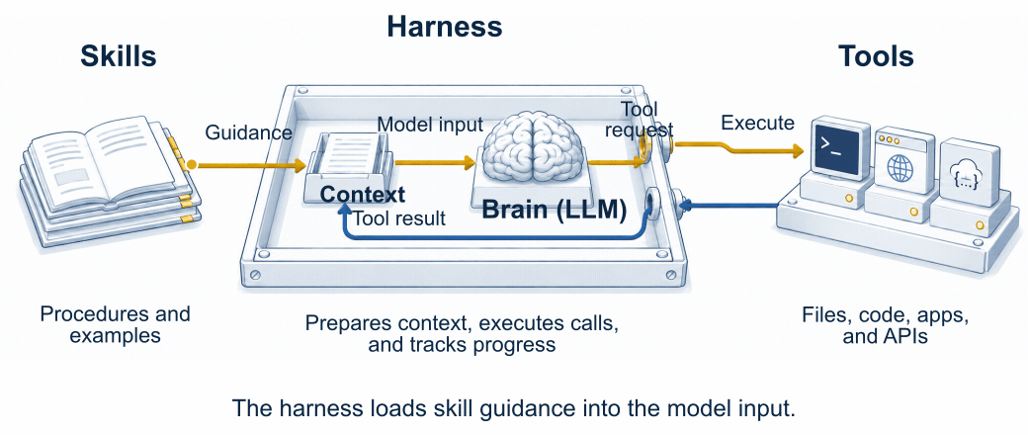
How an agent completes a task
← Anatomy map
Conceptual animation; synthetic research task
06
Notes:
The animation follows the functional diagram: prepare context, choose a tool, execute through the harness, return the observation to context, and choose another action or finish. It is a schematic explanation, not a recording of product performance. In the earnings example, the model reads an excerpt, applies guidance, requests Python work, and returns a table. The model does not execute application functions itself.
Source / attribution: Conceptual animation; synthetic research task

Slide 7
Coding agents and work agents
Coding
Work
Codex · Claude Code
ChatGPT Work · Claude Cowork
Typical work
Typical work
Use these for Python, notebooks, repositories, debugging, and repeatable analysis.
Use these for research, presentations, documents, spreadsheets, and connected work.
Instructor recommendations; October 2026
07
Notes:
Instructor recommendations: learn Codex and Claude Code for coding and repeatable analysis; ChatGPT Work and Claude Cowork for research and deliverables across connected tools. The tasks overlap. Model availability and tool access depend on the product and setup. Cowork isolates code execution in a VM; coding-agent permissions and isolation depend on configuration. Do not rank intelligence by how permissive a product is. https://help.openai.com/en/articles/20001275 https://claude.com/resources/articles/dispatch-and-computer-use https://www.anthropic.com/engineering/how-we-contain-claude
Source / attribution: Instructor recommendations; October 2026

Slide 8
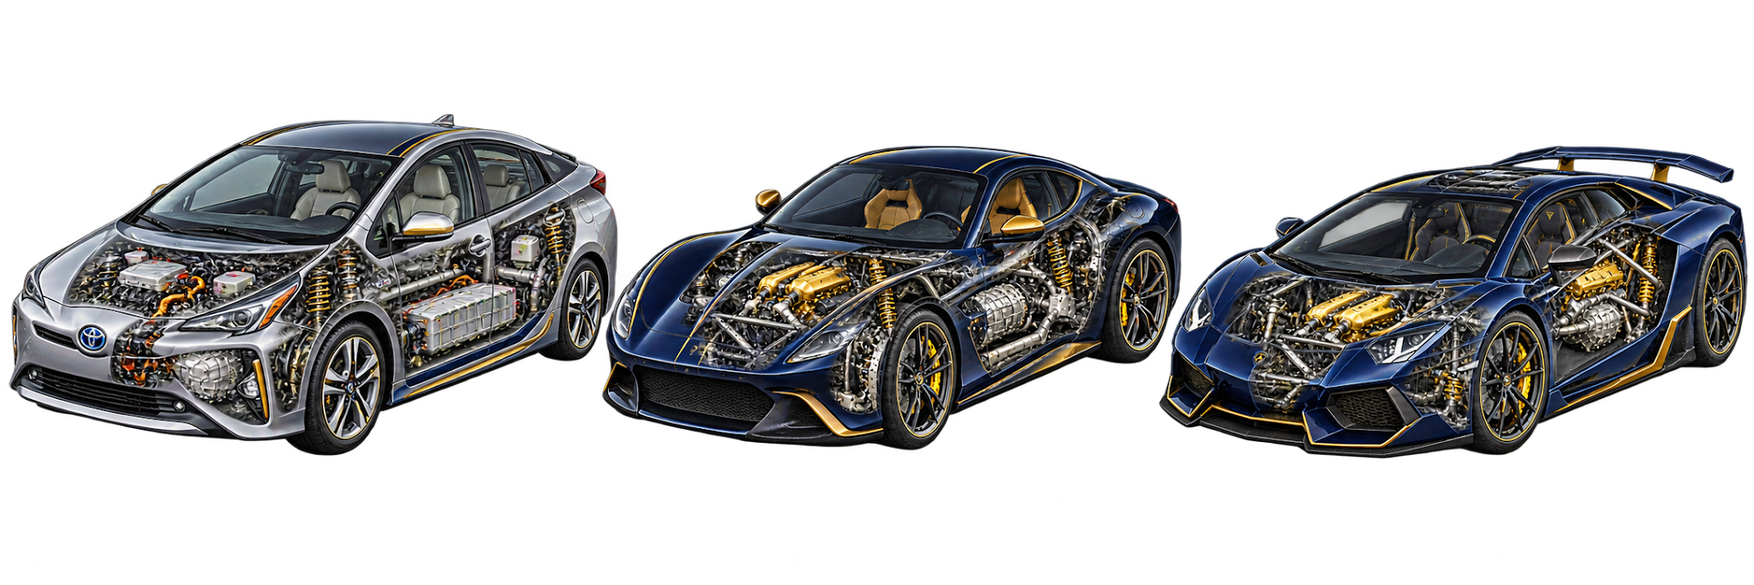
The model and the product
The model is the engine; the product adds tools, context, and controls.
Prius: chat
Ferrari: coding
Lamborghini: work
ChatGPT · Claude
Codex · Claude Code
ChatGPT Work
Claude Cowork
Instructor analogy; generated illustration
08
Notes:
The model is the engine. The product supplies tools, context, controls, and operating rules. In Aneesh’s analogy, chat is a Prius, coding agents are a Ferrari, and work agents are a Lamborghini. Prius: ChatGPT and Claude chat. Ferrari: Codex and Claude Code. Lamborghini: ChatGPT Work and Claude Cowork. This is an interface analogy, not a measured product ranking or literal claim that each interface exposes an identical model. Different products may expose different model choices.
Source / attribution: Instructor analogy; illustration edited with the built-in image-generation tool.

Slide 9
Computer use
Observation
Action
Next observation
→
→
Read a screen or page.
Click, type, or navigate.
Inspect what changed.
Example: copy evidence from an earnings page into a table.
My demo choice
ChatGPT Work
Longer tasks need clear instructions, appropriate access, and checks along the way.
Schematic computer-use example
09
Notes:
Screenshots or page structure supply observations. Clicking, typing, and navigating are actions. The harness executes them and provides the next observation. Suggested bounded demo: read a synthetic earnings page, copy supporting text into a row, and inspect the result. Instructor preference is ChatGPT Work; both ecosystems offer computer use. Reliability depends on task length, ambiguity, access, and checking. Do not claim all computer jobs can be automated reliably. https://claude.com/resources/articles/dispatch-and-computer-use
Source / attribution: Schematic computer-use example

Slide 10
Media generation
Image generation
Video generation
Code and rendering
ChatGPT Images
Nano Banana
Runway
Seedance
SVG · Python · web graphics
Use an image model to create or edit an illustration.
Use a video model to generate a moving scene.
Have an agent write code that renders an image or animation.
Three routes to generating media
10
Notes:
Image models, video models, and code rendered into visual media are three routes that can be combined. Examples: ChatGPT Images and Nano Banana; Runway and Seedance; SVG, Python, or browser graphics. Product names are examples rather than a ranking. https://ai.google.dev/gemini-api/docs/image-generation https://runway.com https://seed.bytedance.com/en/seedance2_0
Source / attribution: Three routes to generating media

Slide 11
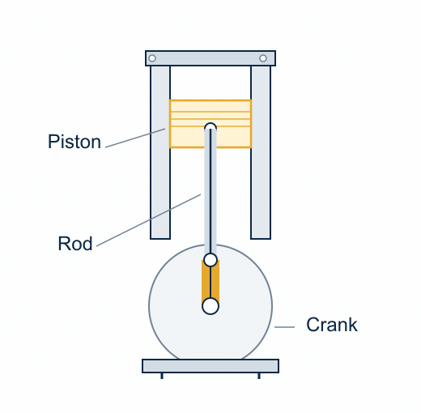
Generating media with code
Ask the agent to animate a mechanism.
angle = time * speed
pin = crank(angle)
piston = slider(pin, rod_length)
render(pin, piston)
The program updates the geometry for each frame.
Code-generated mechanism; anatomy-inspired illustration
11
Notes:
This animation is generated by code, using an ideal slider-crank mechanism. The connecting rod keeps constant length while the crank rotates and the piston moves. Explain the actual workflow: describe the mechanism, have the agent write geometry and motion code, then render it. The short code on the slide is explanatory pseudocode; the full generated program is saved locally. The illustration uses the anatomy skill’s restrained technical linework and functional-motion approach. Attribution: https://github.com/wheresryan22/anatomy. It is an idealized mechanism, not a complete combustion engine.
Source / attribution: Code-generated mechanism; anatomy-inspired illustration

Slide 12
How the harness uses tools
← Anatomy map
Harness
Skills
Tools
Tool
request
Guidance
Model input
Execute
Context
Brain (LLM)
Tool result
Procedures and
examples
Prepares context, executes calls,
and tracks progress
Files, code, apps,
and APIs
A tool result becomes part of the input for the next model call.
The same agent diagram, focused on tool execution
12
Notes:
A tool exposes a name, description, input schema, and returned result. The LLM requests read_excerpt(id=E01); the harness handles validation, permission checks, execution, and returning the result in the next model input. Tools can be local functions, direct API integrations, computer use, or MCP-connected capabilities. Tool outputs contain data to inspect and are not automatically authoritative instructions.
Source / attribution: The same agent diagram, focused on tool execution

Slide 13
Model Context Protocol (MCP)
Agent
MCP client
MCP SERVER
APP / API
›
›
›
Chooses an action
Connects to server
Exposes tools
Data and actions
A protocol defines how systems communicate.
MCP standardizes agent connections, like HTTP does for the web. Tools can also use ordinary APIs.
MCP official introduction
13
Notes:
MCP is Model Context Protocol. A protocol is an agreed set of rules for communication. The HTTP analogy describes interoperability, not an identical protocol or a replacement for HTTP. The host contains an MCP client; a server exposes capabilities and may wrap the application’s API. Agents can also use tools without MCP. https://modelcontextprotocol.io/docs/getting-started/intro
Source / attribution: MCP official introduction

Slide 14
Connecting your sources of context
EMAIL
CALENDAR
Requests and commitments
Time and upcoming events
SLACK
TRANSCRIPTS
Course and team discussion
Fireflies · Granola
Meeting decisions and detail
For me, meeting transcripts are the most useful context source.
Instructor workflow; schematic source categories
14
Notes:
Instructor preference: meeting transcripts are especially valuable, with Fireflies as the primary example and Granola as another option. Email, calendar, and course Slack provide complementary context. A connection provides access; it does not load every record into the current model call. Ask what information the agent would need to help prepare for this course. No private records are shown.
Source / attribution: Instructor workflow; schematic source categories

Slide 15
Skills
← Anatomy map
Reusable instructions
Guidance in context
A skill contains the instructions, examples, and scripts for a particular task.
The harness loads relevant guidance into context, and scripts can run through tools.
A labeling guide
Updating a skill
For earnings analysis, it defines labels and explains what evidence to keep.
Edit the procedure and examples, then check the results. The model's weights stay the same.
Reusable guidance; the library analogy
15
Notes:
Use the library analogy briefly: skills are books for agents. They contain instructions, examples, scripts, and resources. The model reads relevant guidance in context and may invoke accompanying scripts through a tool. Reading a skill changes what the model is given; it does not retrain its weights or guarantee compliance. A skill guides how to use tools; a tool supplies an action.
Source / attribution: Reusable guidance; the library analogy

Slide 16
Example: a labeling skill
SKILL: label-earnings-commentary
1. Read the excerpt and keep its document ID.
2. Mark yes if costs are explicitly linked to lower margins.
3. Quote the text that supports the label.
4. If evidence is missing, choose unclear.
5. Assert exactly one row per document.
The skill gives the agent a repeatable procedure for using the excerpt.
Synthetic earnings-labeling procedure
16
Notes:
Synthetic mini-playbook, not a complete classifier. Margin pressure is present when the excerpt explicitly links higher costs or weaker pricing to lower margins; quote evidence and choose unclear when evidence is insufficient. Assert one row per document. Include clear counterexamples when building evals later. This skill supplies rules and checks; it does not create new model weights.
Source / attribution: Synthetic earnings-labeling procedure

Slide 17
The LLM as a building block
← Anatomy map
{
"model": "MODEL_ID",
"input": [
{"role": "system",
"content": "Quote evidence."},
{"role": "user",
"content": "Label excerpt E01."}
]
}
Input
Your code supplies the instructions and context.
Output
It receives text or a request to call a tool.
Simplified API request; MODEL_ID is illustrative
17
Notes:
Simplified OpenAI Responses-style request. MODEL_ID stands for a model available to your application; tool definitions and optional parameters are omitted. API schemas vary by provider. Your application chooses the instructions, data, tools, and context supplied to the call, then handles the returned text or action requests. https://developers.openai.com/api/docs/guides/function-calling
Source / attribution: Simplified API request; MODEL_ID is illustrative

Slide 18
What goes into the LLM
SYSTEM
Instructions
Quote evidence; use unclear when needed.
USER
Task and data
Label this earnings excerpt.
ASSISTANT
Text or a tool request
Request read_excerpt for E01.
TOOL RESULT
Returned observation
The retrieved earnings excerpt.
TOOL DEFINITIONS
Available functions
Names, descriptions, and argument schemas.
Message roles; provider schemas differ
18
Notes:
System instructions, user messages, assistant responses, and tool-call/results form the structured input history. Tool definitions tell the model which functions are available and what arguments they accept. Some APIs have developer roles and typed function-call items. In OpenAI Responses, function_call and function_call_output are separate typed items; they are not ordinary tool-role messages. Tool output is evidence, not permission to override instructions.
Source / attribution: Message roles; provider schemas differ

Slide 19
Tool calls: requests and results
1 · MODEL REQUESTS
2 · APPLICATION RETURNS
{
"type": "function_call",
"name": "read_excerpt",
"call_id": "call_01",
"arguments": "{\"id\":\"E01\"}"
}
{
"type": "function_call_output",
"call_id": "call_01",
"output": "Costs pressure margins."
}
The call_id links the result to the request.
The model resumes with that result in context.
Responses-style tool call; simplified example
19
Notes:
OpenAI Responses-style example. The model produces function_call, including an arguments string containing JSON. The application executes the function and sends function_call_output with the matching call_id. The call resumes with the earlier conversation and this result included appropriately. Both the tool and earnings text are synthetic. https://developers.openai.com/api/docs/guides/function-calling
Source / attribution: Responses-style tool call; simplified example

Slide 20
Text becomes tokens. Context is finite.
“Uncertainty pressures margins.”
Un
certain
ty
pressures
margins
.
Illustrative split · real boundaries depend on the tokenizer
Tokens are chunks, not always whole words.
Text → tokens → IDs → model → tokens → text
Context: instructions, messages, data, tool results + output budget.
Illustrative token split
20
Notes:
The token split is illustrative, not the output of a specific tokenizer. Tokens can be words, fragments, punctuation, or spaces; token IDs correspond to vocabulary entries. The context includes more than what the user typed. Not everything connected to an agent appears in every call. Limits and accounting vary by model and provider.
Source / attribution: Illustrative token split

Slide 21
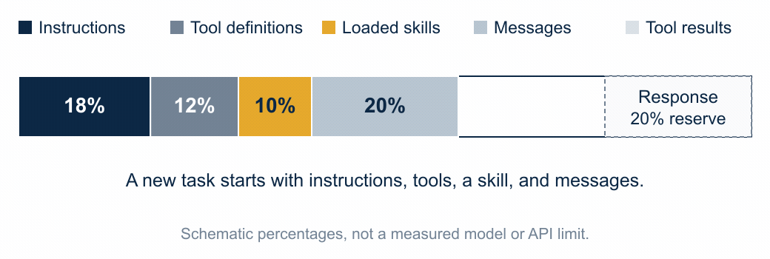
What occupies the context window?
Each call needs room for its input and the model's response.
Schematic context budget; not measured API usage
21
Notes:
The animated bar uses schematic percentages, not real API token counts or a particular model limit. Instructions, tool definitions, a loaded skill, conversation items, and tool results share an input budget. Room is also needed for the response. The initial input is 60%, the first tool result takes it to 80%, and a 20% response reserve uses the full budget. More tool output does not all fit. The managed example uses 62% input and keeps a 20% reserve. Context details and limits vary by API. https://www.anthropic.com/engineering/effective-context-engineering-for-ai-agents
Source / attribution: Schematic context budget; not measured API usageToken boundaries shown are deliberately illustrative, not claimed to match a specific tokenizer. Tokens can be words, subwords, punctuation, spaces, and pieces of non-English text. Token IDs map vocabulary items to numbers; the model learns relationships between their representations. Context includes instructions, conversation, retrieved data, tool outputs, and output budget. Model/provider-specific limits and accounting vary. This is the segue to training, which is outside the current review tranche.
Source / attribution: Illustrative token split · no specific tokenizer

Slide 22
Managing the context window
Keep the task, constraints, essential evidence, and current progress available to the model.
Full tool output
↓
Select / summarize
Retrieve relevant excerpts, save bulky results in files, and summarize earlier steps so the next call has useful context.
Next model input
Relevant excerpts
+ progress notes
The full result stays in a file.
Context selection, retrieval, and compaction
22
Notes:
Keep the task, constraints, essential evidence, and current progress available. Retrieve relevant portions of sources; persist bulky results in files; summarize prior work. The next call can use those excerpts and progress notes rather than all earlier raw output. Compaction can lose details, so retain what later decisions depend on. Durable files/notes are outside the current context and must be retrieved to be seen. https://www.anthropic.com/engineering/effective-context-engineering-for-ai-agents
Source / attribution: Context selection, retrieval, and compactionToken boundaries shown are deliberately illustrative, not claimed to match a specific tokenizer. Tokens can be words, subwords, punctuation, spaces, and pieces of non-English text. Token IDs map vocabulary items to numbers; the model learns relationships between their representations. Context includes instructions, conversation, retrieved data, tool outputs, and output budget. Model/provider-specific limits and accounting vary. This is the segue to training, which is outside the current review tranche.
Source / attribution: Illustrative token split · no specific tokenizer

Slide 23
Which component would you inspect?
A
The agent cannot access the earnings files.
B
The guide uses two definitions of margin pressure.
C
The model still fails with correct data, clear guidance, and useful tools.
D
The tool returns correct data, but the next model call never receives it.
What would you check first, and how would you test it?
Discussion exercise
23
Notes:
Ask students where they would inspect first and what comparison would test their explanation. A: missing file access -> tools/permissions. B: two definitions of margin pressure -> skill/rubric. C: repeatedly cannot solve a clear task despite correct data, guidance, and tools -> compare model capability while holding the rest fixed. D: a tool returns correct data, but the next call never receives it -> harness result/state routing. These are initial diagnoses, not uniquely proven causes. Do not imply every model failure can be fixed through prompting.
Source / attribution: Discussion exercise

Slide 24
Diagnosing an agent
A · Tools
Harness
Skills
Tools
Check access and permissions.
B · Skills
Context
LLM
Check the labeling rules.
C · Brain
Compare models on the same task.
Sometimes the model is the limiting factor, even with good tools, relevant context, and clear guidance.
D · Harness
Check the next call's context.
Suggested first checks; multiple causes are possible
24
Notes:
Review the same four parts and explain why each proposed first check follows from the observed failure. Model capability can be the bottleneck even with clear guidance and useful tools. Hold the rest of the system fixed when comparing models. Other failures require improving the skill, access, or harness. Transition question: where do the model’s capabilities come from? Stop after this section for Aneesh’s review.
Source / attribution: Suggested first checks; multiple causes are possible

Slide 25
How LLMs
are trained
UC Berkeley · Master of Financial Engineering
Lesson 3 · Part 2
How training changes the model’s weights.
October 12, 2026
Notes:
Part 2 of Lesson 3. Start from the brain in the agent figure. Training changes model parameters, usually called weights. Pre-training develops broad prediction capability; post-training adapts behavior using demonstrations and feedback. Today’s teaching model is deliberately simple. Stop after this section for review before building evals.
Source / attribution: Instructor outline

Slide 26
Knowledge and behavior
Pre-training
Post-training
Builds a world model.
The model learns knowledge, relationships, and patterns from a broad corpus.
Shapes behavior.
The model learns how to use that knowledge to follow instructions, use tools, and act.
Knowledge about the world. Behavior in the world.
A useful high-level mental model
26
Notes:
Use Aneesh’s knowledge/behavior frame at the front of training. A world model is learned statistical structure, not a guaranteed factual database or literal simulator. This is a useful emphasis rather than a strict partition: post-training can add knowledge and pre-training also influences behavior. Both update weights. Connect back to the brain inside the harness.
Source / attribution: A useful high-level mental model

Slide 27
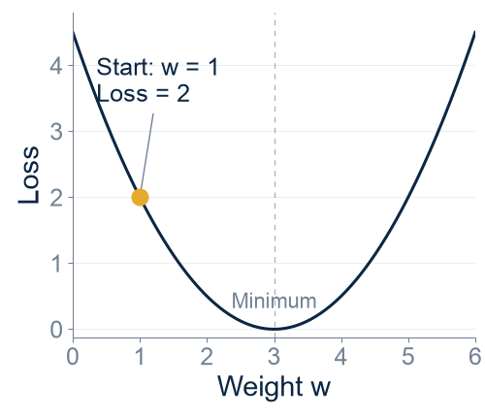
What a training step does
Prediction = w × x
Here, x = 1 and target = 3.
Start: w = 1
Prediction = 1
Loss = ½(1 − 3)² = 2
Gradient = w − 3 = −2
Should w move left or right to reduce the loss?
Show the parameter update
Toy example: L(w) = ½(w − 3)²
27
Notes:
Use x=1, target y=3, prediction y_hat=w*x, starting weight w=1. Prediction is 1, loss is 2, and gradient dL/dw is -2. Ask students whether w should move left or right on the loss curve. The model makes a prediction, loss measures error, backpropagation computes derivatives, and the optimizer uses them to update weights. The next slide reveals the steps. No automatic timer. This is squared error for an introductory toy, not the usual language-model training loss. https://www.deeplearningbook.org/contents/optimization.html
Source / attribution: Toy example: L(w) = ½(w − 3)²

Slide 28
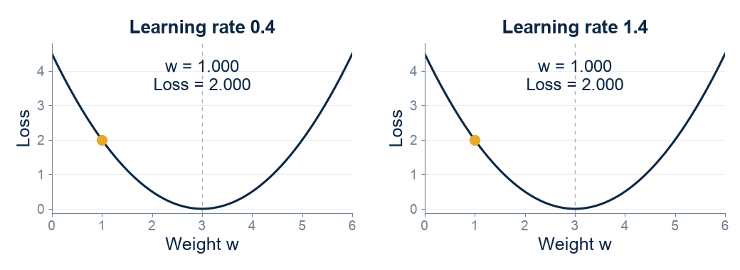
Gradient descent
Training overview
new weight = old weight − learning rate × gradient
Computed toy curves, identical loss and starting weight
28
Notes:
Both panels use L(w)=0.5*(w-3)^2, gradient w-3 and start at w=1. With learning rate 0.4, w becomes 1.8, 2.28, 2.568. With rate 1.4 it becomes 3.8, 2.68, 3.128. The larger rate overshoots and oscillates but converges for this particular quadratic. Do not imply every overshoot diverges. For this toy rates above 2 diverge, while rate 2 keeps the same loss. Real optimization operates in many dimensions and often uses adaptive optimizers. The animation compares both rates on the same loss curve. https://www.deeplearningbook.org/contents/optimization.html
Source / attribution: Computed toy curves, identical loss and starting weight

Slide 29
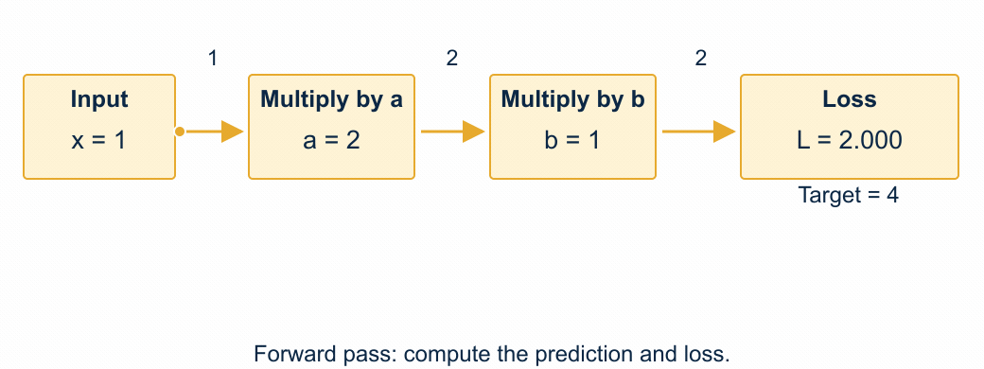
Backpropagation
Training overview
Backpropagation computes gradients. The optimizer updates weights.
Toy chain without activations
29
Notes:
The chain is x=1, a=2, h=a*x=2, b=1, prediction b*h=2, target=4 and L=0.5*(prediction-4)^2=2. By the chain rule dL/db=(2-4)*h=-4 and dL/da=(2-4)*b*x=-2. Backpropagation computes these gradients. A gradient step with eta=0.1 updates a=2.2 and b=1.4, giving prediction 3.08 and loss 0.4232. Both derivatives use the original weights and both updates occur together. The animation separates the computation and update. A full neural network has many such operations and nonlinear activations. Reading: Goodfellow, Bengio and Courville, Deep Learning, chapters 6 and 8. https://www.deeplearningbook.org/contents/optimization.html
Source / attribution: Toy chain without activations

Slide 30
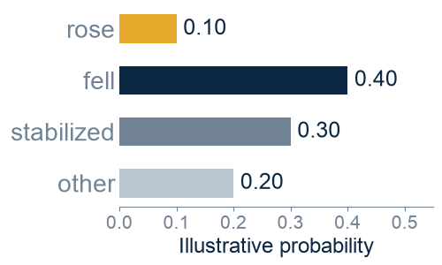
Pre-training
Margins declined
because costs ____
Observed next token:
rose
P(rose) = 0.10
Loss = −ln(0.10)
= 2.30
If P(rose) rises to 0.60,
loss falls to 0.51.
Illustrative probabilities, not a captured model response
30
Notes:
For a language model, the corpus supplies the next-token target. The example uses the prefix “Margins declined because costs” and observed next token “rose”. Display toy probabilities 0.10 for rose, 0.40 fell, 0.30 stabilized, 0.20 other. Cross-entropy for the observed token is -ln(0.10)=2.3026. After many illustrative updates, the observed token probability could be 0.60, giving loss 0.5108. The probabilities are invented solely to teach the loss, not measurements from a real model. The word boundaries are illustrative; actual tokenizer output can differ. Training repeats across many positions and examples. Different modalities and architectures can use different objectives. https://ai.meta.com/blog/meta-llama-3-1/
Source / attribution: Illustrative probabilities, not a captured model response

Slide 31
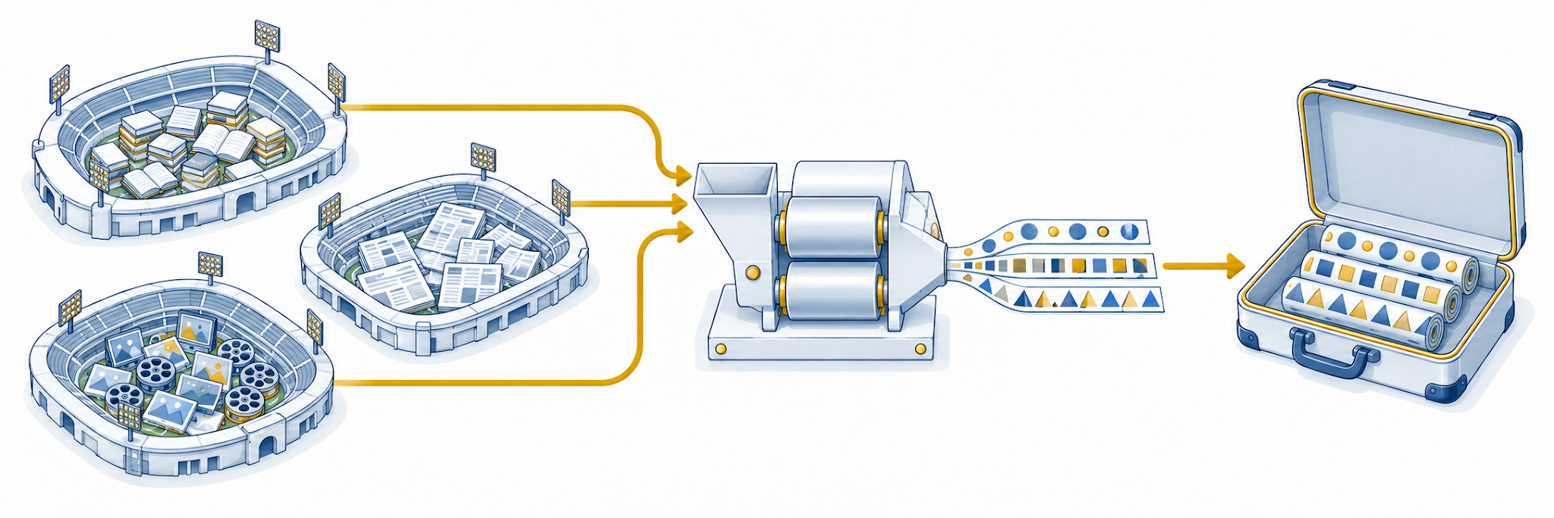
Stadiums of information in a suitcase
Training corpus
Repeated updates
Learned weights
Pre-training builds a world model from learned knowledge and patterns.
Instructor analogy, generated conceptual illustration
31
Notes:
The stadiums represent the huge training corpus; the suitcase represents learned parameters. Repeated prediction and updates capture reusable statistical patterns. This is a metaphor for learned structure, not lossless storage of the original corpus. Models can generalize and can also memorize or make errors. Examples include grammar, coding conventions, relationships, and reasoning patterns. The illustration intentionally transforms raw media into recurring patterns. Optional entropy sidebar: prediction uncertainty relates to compression, but lower loss alone does not demonstrate truth or a complete world model. Do not add a quantitative compression ratio.
Source / attribution: Instructor analogy, generated conceptual illustration

Slide 32
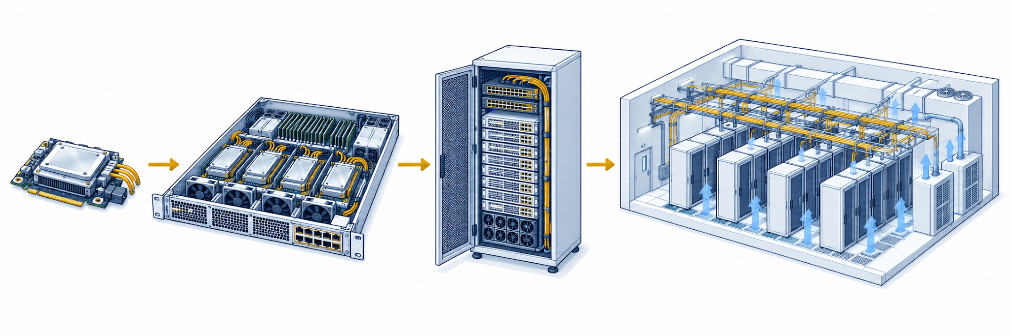
The physical scale of pre-training
Historical example: Llama 3.1 405B (2024)
GPU
Server
Rack
Cluster
15T+ training tokens and 16,000+ H100 GPUs
Meta, Llama 3.1 training description, July 2024
32
Notes:
Meta disclosed that Llama 3.1 405B trained on over 15 trillion tokens using over 16 thousand H100 GPUs. This is a historical disclosed example, not a claim about a typical model or an undisclosed 2026 run. The illustration shows a GPU module, server, rack and a data-center cluster. Counts and physical proportions in the drawing are schematic and do not imply a specific rack configuration. Networking, storage, power, cooling and fault recovery enable the hardware to operate together. Do not infer power draw, number of racks, footprint or training cost without explicit hardware assumptions. https://ai.meta.com/blog/meta-llama-3-1/
Source / attribution: Meta, Llama 3.1 training description, July 2024

Slide 33
Post-training
SFT
Supervised fine-tuning
Useful responses and example tool calls.
Preferences
Preference optimization
Judgments about which response is better.
RL
Reinforcement learning
Scored attempts with checks or feedback.
Labs can combine and repeat these methods.
Examples of post-training signals
33
Notes:
Pre-training provides a base model. Supervised fine-tuning teaches from demonstration responses, including examples of tool use. Preference optimization learns from comparisons between responses. Reinforcement learning learns from scored attempts, including verifiable outcomes such as test results. These can be combined and repeated; this is not a universal three-stage recipe. Meta’s Llama 3.1 description includes SFT and DPO, while DeepSeek-R1 illustrates large-scale RL combined with other stages. Distinguish post-training methods from adding instructions to a deployed agent. https://ai.meta.com/blog/meta-llama-3-1/ https://arxiv.org/abs/2501.12948
Source / attribution: Examples of post-training signals

Slide 34
The reinforcement-learning setup
State
What exists
Repository and settings.
Observation
What the model sees
Files and test output.
Action
What the agent does
Read, edit, or run a command.
Policy
How actions are chosen
Probabilities for next actions.
Reward
A training signal
Score from the task checks.
Episode
One complete attempt
From reset to termination.
Synthetic coding task: repair a CSV parser
34
Notes:
Define state as repository and environment configuration, observation as the visible files and test output, action as read/edit/run, policy as the distribution over next actions, reward as a score from task checks, and episode as one attempt from reset to termination. The model may only observe part of the state and uses its available history to act. A reward is a training signal and may imperfectly represent success. In the next slide show the environment loop and a distinct weight-update process.
Source / attribution: Synthetic coding task: repair a CSV parser

Slide 35
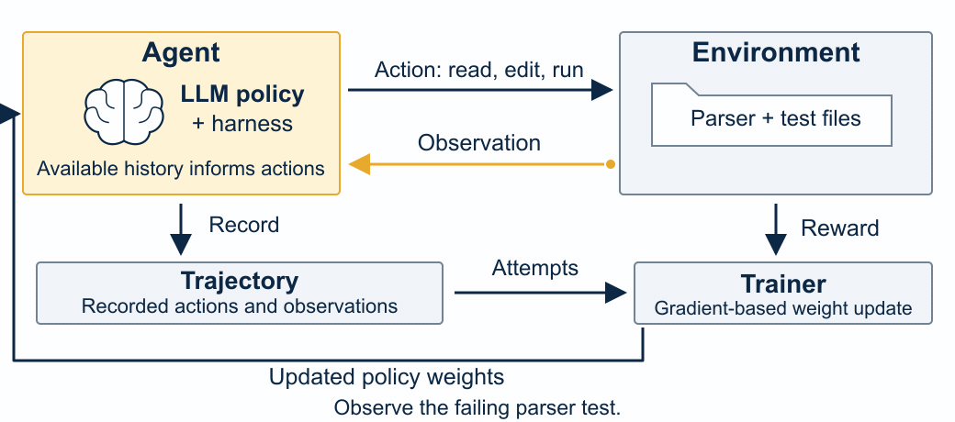
From an attempt to a policy update
Training overview
Schematic RL workflow, synthetic parser task
35
Notes:
A rollout reads the failing case, edits the parser, runs checks, then finishes. The environment returns observations after actions. At termination a verifier provides a score. A separate trainer uses trajectories, action probabilities and rewards to construct a training objective and updates policy weights through gradients. There is no differentiable arrow through the external tests or environment. This is a schematic terminal-reward example; algorithms may also use intermediate rewards or learned reward models. Ordinary agent execution performs the rollout without this automatic training step. https://arxiv.org/abs/2501.12948
Source / attribution: Schematic RL workflow, synthetic parser task

Slide 36
Training environments
Arithmetic
Calculate 17 × 23
Exact answer: 391
Repository
Fix a CSV parser
Executable tests
Game
Play StarCraft II
Game outcome
Workplace
Build an evidence table
Evidence and deliverable checks
Each attempt needs a reset and a way to score its result.
AlphaStar is a historical RL example, not an LLM
36
Notes:
An environment supplies a world, observations, actions, tasks, reset conditions and a grading method. Arithmetic uses a target answer, a coding repository uses executable checks, games provide interacting state and game outcomes, and workplaces combine records, applications and deliverables. AlphaStar in StarCraft II used supervised initialization and subsequent league reinforcement learning. It was not an LLM post-training project. Games expose limited observations and delayed outcomes. Do not equate winning a game with success at knowledge work. https://deepmind.google/blog/alphastar-grandmaster-level-in-starcraft-ii-using-multi-agent-reinforcement-learning/
Source / attribution: AlphaStar is a historical RL example, not an LLM

Slide 37
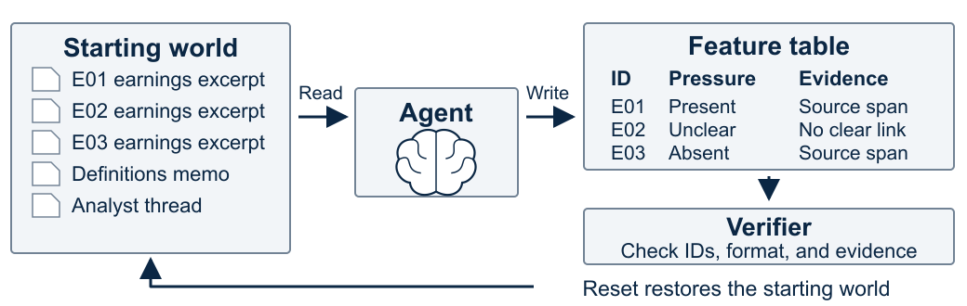
A workplace as a training environment
Prepare a margin-pressure table for E01, E02, and E03.
What would a verifier that checks only row count miss?
Synthetic financial-research environment
37
Notes:
A synthetic task asks an agent to prepare a margin-pressure feature table from three earnings excerpts, a definitions memo and a Slack-like analyst thread. Actions read records, write rows and run checks. Reset restores the starting files and messages. Hidden reference evidence, required IDs and output format support grading. The drawing is conceptual and contains no real messages or private documents. Expert judgment may still be necessary for semantic correctness. Ask what a verifier that checks only row count would miss. This question prepares the next section on evals without teaching its full workflow.
Source / attribution: Synthetic financial-research environment

Slide 38
Why domain experts matter in training
Mercor
Handshake
Builds realistic worlds and tools, with tasks and verifiers that let agents practice work.
Connects domain experts with labs to write prompts, assess responses, and judge quality.
Mercor Research
Handshake AI
Domain experts define useful tasks and what counts as success.
Mercor Research and Handshake AI descriptions
38
Notes:
Companies support AI labs by creating expert tasks, environments, demonstration data and judgments. Mercor describes realistic data-rich worlds, tools, tasks and verifiers. Handshake describes domain experts writing prompts and assessing responses. These are distinct roles rather than interchangeable offerings. Avoid valuation claims and promises about any particular dataset’s effect. The economic mechanism is that useful hard tasks reveal gaps; experts define success; diverse tasks and credible grading supply better signals for training. Repeated optimization may exploit a flawed reward, such as rewarding row count while ignoring fabricated evidence. https://www.mercor.com/research/ https://joinhandshake.com/blog/our-team/introducing-handshake-ai/
Source / attribution: Mercor Research and Handshake AI descriptions

Slide 39
Training and using an agent
Training
Using an agent
Examples and feedback feed a training objective. An optimizer changes the model’s weights.
The harness supplies context and executes tool calls. A new instruction or skill guides the next call.
Deep Learning, chapters 6 and 8
Reinforcement Learning, chapters 1 and 3
How do we tell whether an agent actually got better?
Reading: Deep Learning and Reinforcement Learning: An Introduction
39
Notes:
During training the model’s parameters change. During ordinary inference the agent uses current weights with context supplied by its harness. Improving tools, skills or context can improve performance without changing those weights. Product feedback and conversations may be used in separate training processes under product settings, but this does not mean every call immediately retrains the deployed model. Ask what evidence would show improvement when the reward is only row count. The next section will teach how to define and measure success. Stop for Aneesh’s review now. Reading: Ian Goodfellow, Yoshua Bengio, Aaron Courville, Deep Learning (chapters 6 and 8), https://www.deeplearningbook.org/ ; Richard S. Sutton and Andrew G. Barto, Reinforcement Learning: An Introduction (chapters 1 and 3), http://incompleteideas.net/book/the-book-2nd.html . The Sutton author site was unavailable during source verification; use the stable bibliographic reference and publisher link https://mitpress.mit.edu/9780262039246/reinforcement-learning/.
Source / attribution: Reading: Deep Learning and Reinforcement Learning: An Introduction

Slide 40
Evaluating
agents
UC Berkeley · Master of Financial Engineering
Lesson 3 · Part 3
How we define, verify, and measure useful work.
October 12, 2026
Notes:
Part 3. How do we know whether the system did useful work? Move from environments and reward to tasks, trials, transcripts, outcomes and graders. We will inspect one synthetic earnings-analysis deliverable, use executable checks, examine a model rubric and human calibration, and verify database state. Follow Anthropic terminology while making the classroom examples our own.
Source / attribution: https://www.anthropic.com/engineering/demystifying-evals-for-ai-agents

Slide 41
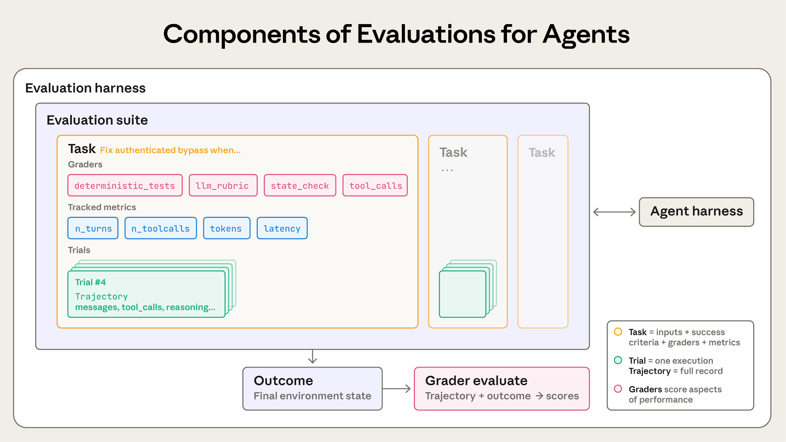
The parts of an eval
Anthropic, Demystifying evals for AI agents (2026)
41
Notes:
Authentic Anthropic diagram, used without alteration. Evaluation harness wraps a suite of tasks, runs trials against the agent harness, records trajectories and outcomes, and applies graders. Point to the two harnesses: one enables work, the other measures it. The diagram’s reasoning refers to information actually available in logs, not access to hidden chain-of-thought. We will unpack this dense diagram on the next slide.
Source / attribution: https://www.anthropic.com/engineering/demystifying-evals-for-ai-agents

Slide 42
Tasks, trials, and results
Task
One defined problem
Inputs and success criteria.
Trial
One attempt
Repeat with a fresh reset.
Transcript
The recorded trace
Messages, calls, observations.
Outcome
What finally exists
Saved files or database state.
Grader
A scoring method
Checks a part of the work.
Terminology: Anthropic (2026)
42
Notes:
A suite collects tasks. The evaluation harness resets the world, runs trials, records available traces, executes graders and aggregates metrics. The agent harness supplies context, tools and execution while doing the task. A transcript supports diagnosis; the outcome shows what actually changed. No assertion of hidden reasoning access.
Source / attribution: https://www.anthropic.com/engineering/demystifying-evals-for-ai-agents

Slide 43
A concrete evaluation task
Agent’s task
Success criteria
Read five earnings excerpts. Save one row per ID in features.csv.
Label current-quarter margin pressure as Present, Absent, or Unclear.
Every ID appears exactly once.
Each row has an exact evidence quote and a label supported by that excerpt.
What checks would you write before running the agent?
Synthetic classroom examples. Code and database checks executed locally.
43
Notes:
Five synthetic excerpts E01–E05, no real issuers. Present requires explicit current-quarter margin pressure. Absent includes explicit denial or improvement. Unclear means the excerpt does not establish the impact. Each row needs nonempty exact evidence from its own excerpt. The eval runner keeps reference labels and grading code outside the agent workspace. Reset inputs and output path for every trial. The assistant cannot decide its own score.
Source / attribution: Synthetic classroom examples. Code and database checks executed locally.

Slide 44
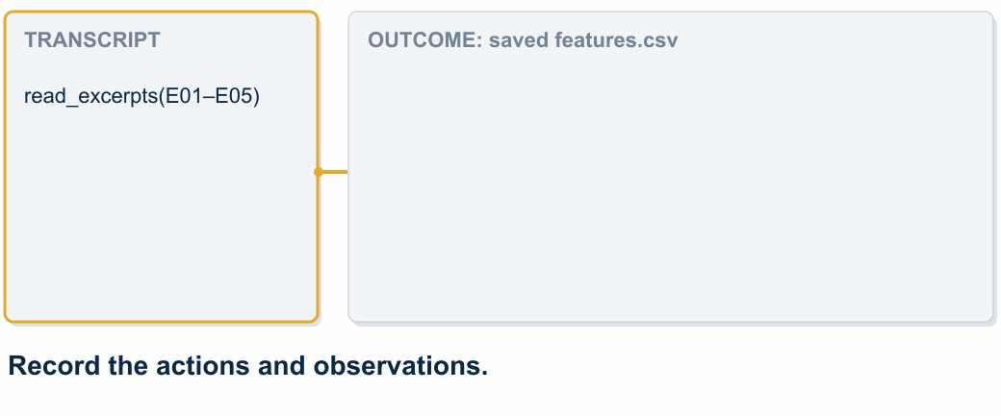
Transcript and outcome
Eval overview
Constructed transcript and CSV; saved output checked by code
44
Notes:
Illustrative tool transcript, not a captured live model run. The agent reads excerpts, writes candidate-a.csv and claims all five are complete. Open the actual artifact: E01 appears twice, E04 is missing, E03 has a fabricated quote, E02’s label mishandles negation. Five rows alone passes. Ask students to identify two checks before the reveal. The next slide exposes actual checker results on this artifact.
Source / attribution: Constructed transcript and CSV; saved output checked by code

Slide 45
Code-based graders
Checks on the saved CSV
Executed result: candidate A
len(rows) == 5
(Counter(ids) ==
Counter(expected))
all(q in excerpts[i]
for i, q in evidence)
row_count PASS
IDs FAIL
missing: E04
duplicate: E01
evidence FAIL
E03 quote absent
A valid shape can still contain wrong evidence.
Synthetic classroom examples. Code and database checks executed locally.
45
Notes:
These displayed expressions summarize the executable fixtures.py grader. Exact ID multiset detects both omissions and duplicates. Exact quote membership checks evidence provenance, not semantic support. Fixed hidden reference labels can also be checked with code, but new ambiguous content may need semantic judgment. Actual synthetic output fails success. Counter expected contains every required ID exactly once. Test graders against accepted and rejected fixtures. No cost or latency is invented.
Source / attribution: Synthetic classroom examples. Code and database checks executed locally.

Slide 46
Model-based graders
Evidence and rubric
Illustrative judgment
“Higher freight costs did not reduce margins this quarter.”
Candidate label: Present
Does the quote support current-quarter margin pressure?
supported: false
expected_label: Absent
reason: The excerpt explicitly denies a margin reduction.
The quote exists. Its meaning still needs checking.
Synthetic rubric and illustrative judge response
46
Notes:
This structured output is illustrative, not an executed judge API call. A model grader receives the source excerpt, candidate row and explicit rubric. Score one dimension at a time: whether the evidence supports the label. Include Unknown when evidence cannot establish a judgment. For this fixed case a reference code check suffices too. Calibrate a model judge against expert human decisions and inspect systematic errors such as negation, time period and plausible fabricated evidence. A judge model can be mistaken or biased. Keep candidate text treated as data rather than instructions.
Source / attribution: Synthetic rubric and illustrative judge response

Slide 47
Human graders and calibration
Clear decline
“Costs reduced margins.”
Present
Explicit denial
“Costs did not reduce margins.”
Absent
Time ambiguity
“Costs may hurt next quarter.”
Unclear for this quarter
Disagreement often reveals a missing rule. Here, the period matters.
Illustrative calibration exercise; no measured human study
47
Notes:
Humans supply domain judgment, write reference examples and calibrate automatic graders. Ask students to decide the third case before showing the period restriction. If two reviewers disagree, clarify the rubric and adjudicate the reference instead of averaging an undefined concept. Track judge agreement with adjudicated labels on a held-out calibration set. These are expected labels in a classroom exercise, not reported model/human agreement measurements.
Source / attribution: Illustrative calibration exercise; no measured human study

Slide 48
Outcome verification
Agent claim: “Refund completed.”
Code-based state check
Saved database state
order_id C17
amount 75
status pending
SELECT COUNT(*)
FROM refunds
WHERE order_id = 'C17'
AND amount = 75
AND status = 'completed';
result: 0 FAIL
The verifier checks the changed world.
Executed query against a local synthetic SQLite database
48
Notes:
Actual local SQLite query returns zero matching rows. The database is synthetic and no payment occurs. The target criterion in this toy is exactly one completed refund record for C17 amount 75. Production criteria also need currency, authorization and downstream execution appropriate to their real task. This is outcome verification implemented by a code-based grader, not a fourth grader category. tau-bench similarly compares final database state with task goals. https://arxiv.org/abs/2406.12045
Source / attribution: Executed query against a local synthetic SQLite database

Slide 49
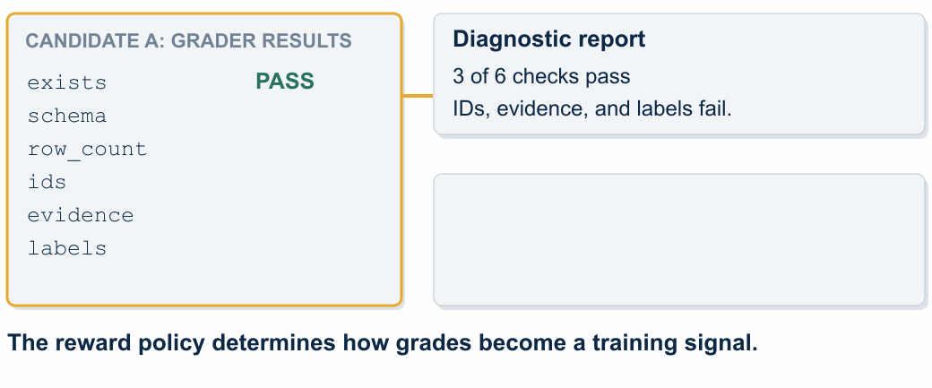
Grades and reward signals
Eval overview
Executed fixture grades; illustrative reward policy
49
Notes:
Candidate A passes file existence, schema and row count, but fails IDs, evidence and labels. Keep the six diagnostic grades visible. For this illustrative task use a strict success reward: reward 1 only when all required checks pass, otherwise 0. This intentionally gives A reward 0 even with 3/6 checks passed. Partial diagnostics remain useful for learning where it failed. A different task might use carefully designed partial reward. An eval can report these scores without changing weights. A trainer can consume graded rollouts to build an RL objective and update weights separately. External code tests are not differentiated through. Reward quality depends on verifier quality.
Source / attribution: Executed fixture grades; illustrative reward policy

Slide 50
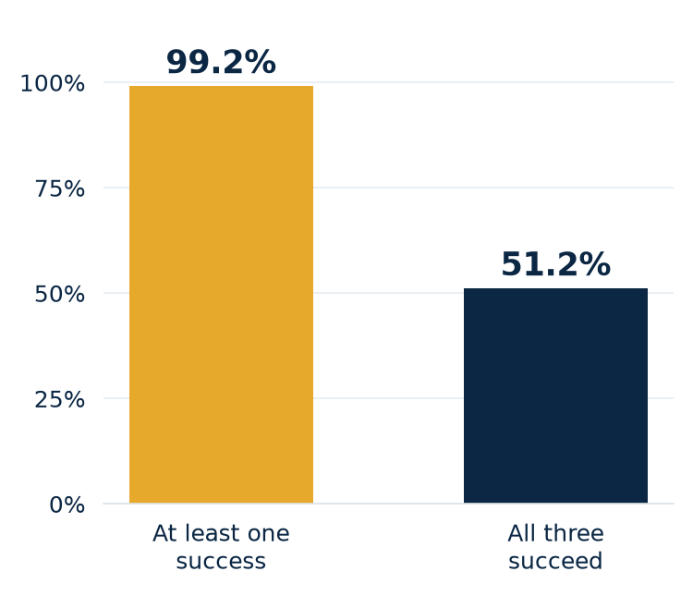
Reliability across trials
Each attempt succeeds with probability 80%.
pass@3 = 1 − (1 − p)³
= 99.2%
pass^3 = p³ = 51.2%
At least one success and consistent success answer different questions.
Computed illustration: independent trials, p = 0.80
50
Notes:
For three independent trials, each with identical success probability .8, pass@3 = 1-(1-.8)^3 = .992 measures at least one successful attempt. pass^3 = .8^3 = .512 measures all three successful attempts. These are mathematical illustrations, not measured agent benchmark results. Dependence or differing task difficulty invalidates this simple calculation. Repeat actual trials with recorded conditions and report task-level variation and uncertainty. At least one success is useful when retry and selection are possible. Consistency matters in repeated workflows. Terminology: Anthropic and tau-bench https://arxiv.org/abs/2406.12045
Source / attribution: Computed illustration: independent trials, p = 0.80

Slide 51
Capability and regression evals
Capability evals
Regression evals
Probe harder work the agent still struggles with.
Mixed evidence, negation, time periods, and multiple documents.
Protect work the agent already handles.
Required IDs, exact quotes, clear labels, and saved output.
A useful suite includes clear successes and difficult cases.
Terminology: Anthropic; synthetic earnings tasks
51
Notes:
Capability tests expose opportunities; regression tests catch losses after changes. Promote stable capability tasks into the regression suite once performance becomes reliable. Cover positive, negative and unclear cases. A suite of only easy positives can hide false positives and saturation. Difficulty should come from the work, not unclear instructions or broken environments.
Source / attribution: https://www.anthropic.com/engineering/demystifying-evals-for-ai-agents

Slide 52
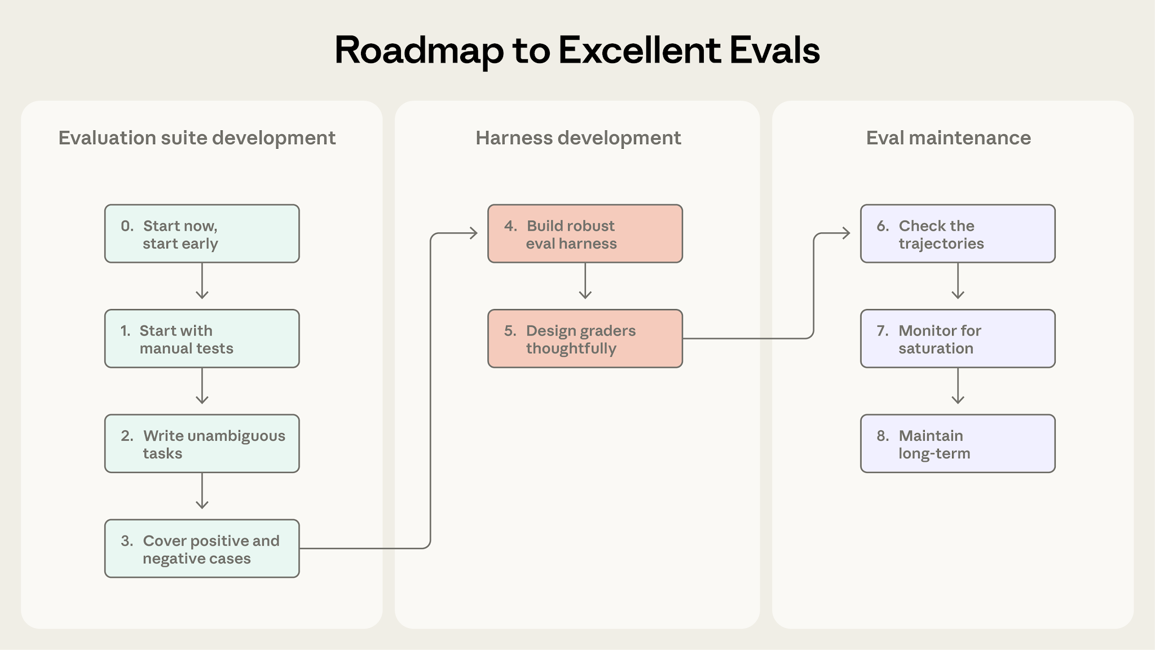
Building an evaluation suite
Anthropic, Demystifying evals for AI agents (2026)
52
Notes:
Authentic Anthropic roadmap, unaltered. Begin with real manual checks and observed failures. Our CSV case becomes a precise task with reference rows and balanced cases. The harness resets files, records traces and grades artifacts independently. Maintain the suite by reading failures and adding harder tasks when it saturates. Treat the source image as a roadmap to revisit. Our next slide gives a concrete local workflow rather than restating all article steps.
Source / attribution: https://www.anthropic.com/engineering/demystifying-evals-for-ai-agents

Slide 53
An eval-driven improvement cycle
Inspect failure
A: duplicate and fake quote
IDs FAIL, evidence FAIL
Revise the skill
Require ID and quote checks
Same task and grader
Test the revision
B: all references correct
All six checks PASS
This demonstrates the workflow. Repeated held-out trials would test whether the agent improved.
Two constructed candidate artifacts, checked by the same code
53
Notes:
The local code executes against two authored fixtures: A fails IDs, evidence and labels; B passes all six checks. This is an illustration of the improvement workflow, not empirical evidence that a real agent improved. A real experiment would run baseline and revised skill repeatedly on the same development suite under controlled conditions, then evaluate held-out tasks. Read transcripts to locate failures, change one component, compare success plus cost/latency where measured, and add the failure as a regression task. Grader integrity matters: hidden references remain outside the agent environment and grading failures are distinct from agent failures.
Source / attribution: Two constructed candidate artifacts, checked by the same code

Slide 54
Development and held-out tasks
Development suite
Held-out evaluation
Use failures to improve prompts, skills, tools, or the harness.
Repeated inspection makes these tasks part of development.
Freeze separate tasks and references before tuning.
Use them to check whether improvements carry to new work.
For financial tasks, split by time and keep future data out.
Evaluation design; classroom financial-research example
54
Notes:
Repeatedly choosing changes by a test score adapts the system to that test, even without changing weights. A final held-out set checks generalization. If tuning or training a classifier, training data fit parameters, validation data select choices, and final test data assess the selected system. In agent development the analogous separation is development tasks versus untouched final evaluation. Finance requires temporal and often issuer/event separation; avoid future information and duplicated excerpts across splits. Five classroom examples are diagnostics, not a robust accuracy estimate.
Source / attribution: Evaluation design; classroom financial-research example

Slide 55
PsychBench: outcomes and behavior
Game outcomes
Behavioral measurements
A controlled poker environment produces actions and game results.
Measure chip returns and win rates.
Four model raters score visible summaries for emotion, cognition, action, and other behaviors.
Their ratings form a consensus.
Open PsychBench
One environment can support several different measurements.
PsychBench methodology, accessed October 11, 2026
55
Notes:
Verified site describes a controlled poker environment, ECAAMS (Emotion, Cognition, Action, Arousal, Meaning, Social), 19 dimensions from visible reasoning summaries and four independent LLM raters for consensus. Game outcomes and inferred behavioral labels are separate measurements. Do not claim access to hidden chain-of-thought or diagnose humanlike mental states. Interpret raters through their rubric and calibration. Poker performance does not establish real-market profitability. Link lets instructor open the benchmark as a live example. Omit changing leaderboard/model/game counts.
Source / attribution: https://www.psychbench.ai/

Slide 56
What an eval lets you improve
What you change
How you measure it
Brain: training or model choice.
Harness: context and execution.
Tools: capabilities and access.
Skills: procedures and checks.
Defined tasks and success criteria.
Repeatable trials and credible graders.
Results on untouched tasks.
Next: using LLMs to put structure on messy data.
Lesson 3 synthesis
56
Notes:
A common measurement framework helps improve any of the four parts. Independent practitioners often have greatest control over tools, skills and harness, while changing model weights is a separate training choice. Evals support both agent development and training reward construction. Domain expertise is central to writing useful tasks and recognizing whether the evidence supports a decision. Stop here for Aneesh’s review. Do not build the decision-model section yet.
Source / attribution: Lesson 3 synthesis

